Slide 1
Are University Admissions Involved in Ethical Issues for Gaining a Higher Rank?
Team B7 - Obliviate
Fusu, Caroline, Yihan, Tommy, Allen, Michael

Slide 2
Contents
Introduction
Feedback Loop
Analytics Based on Ethical Framework
Ranking Creates Inequality
Misinformation & Fake News
Summary, Limitations & Looking Forward

Slide 3
Introduction

Slide 4
University Rankings
US News & World Report
QS - Quacquarelli Symonds
Forbes
“Expert advice, rankings and data to help you navigate your education journey and find the best college for you.”
“Discover which universities are the best in the United States with the QS World University Rankings”
"Our new ranking better accounts for which schools are serving as true engines of the American Dream”
Notes:
3 major ranking systems

Slide 5
Ranking Factors
US News
QS
Forbes
Graduation and retention rates - 22%
Social mobility - 5%
Graduation rate performance - 8%
Faculty resources - 20%
Undergraduate academic reputation - 20%
Student selectivity for the fall 2020 entering class - 7%
Financial resources per student - 10%
Average Alumni giving rate - 3%
Graduate indebtedness - 5%
Academic Reputation - 40%
Employer Reputation - 10%
Faculty/Student Ratio - 20%
Citations per faculty - 20%
International Faculty Ratio - 5%
International Student Ratio - 5%
Alumni salary - 20%
Debt- 15%
Return on investment - 15%
Graduation rate - 15%
Forbes American Leaders list - 15%
Retention rate - 10%
Academic success - 10%
Notes:
Methodology use and corresponding weights how they calculate

Slide 6
2. Feedback Loop
Issue related with use of proxy

Slide 7
What can a higher ranking represent in reality?
What can a higher Ranking represent for schools?
What can a higher Ranking represent for students?
What can a higher Ranking represent for employers?
Better academic ability / performance
Much more funding
Higher quality of student
…
Better resource
Greater job seeking chance after graduation
Social networking chance
…
Better employees with diverse skills
Potential investment
…

Slide 8
What can they do to increase possible ranking?
Faculty Recruiting
Students Admission
Reputation Gaining
Ethical ways society recommended: Increase teaching & research quality, attract better students resource and rankings will follow;
‘More efficient’ ways of achieving it:
Recruit faculties with higher academic reputation to increase measurement for ‘citation’ or ‘publication’
Admit students potentially can bring higher feedback
Schools in the same system may grade each other higher during peer evaluation;
Buying for reputation

Slide 9

Possible Feedback Loop
College ranking cannot directly measure the college quality, but it is correlated with colleges’ academic outcomes.
Academic/Employer Reputation
College Quality
Students’ background, Financial Resource
Alumni
Peer Assessment
Academic Outcome
Proxy
College Ranking
Better Education,
Better Resource

Slide 10
3. Analytics Based on Ethical Framework

Slide 11
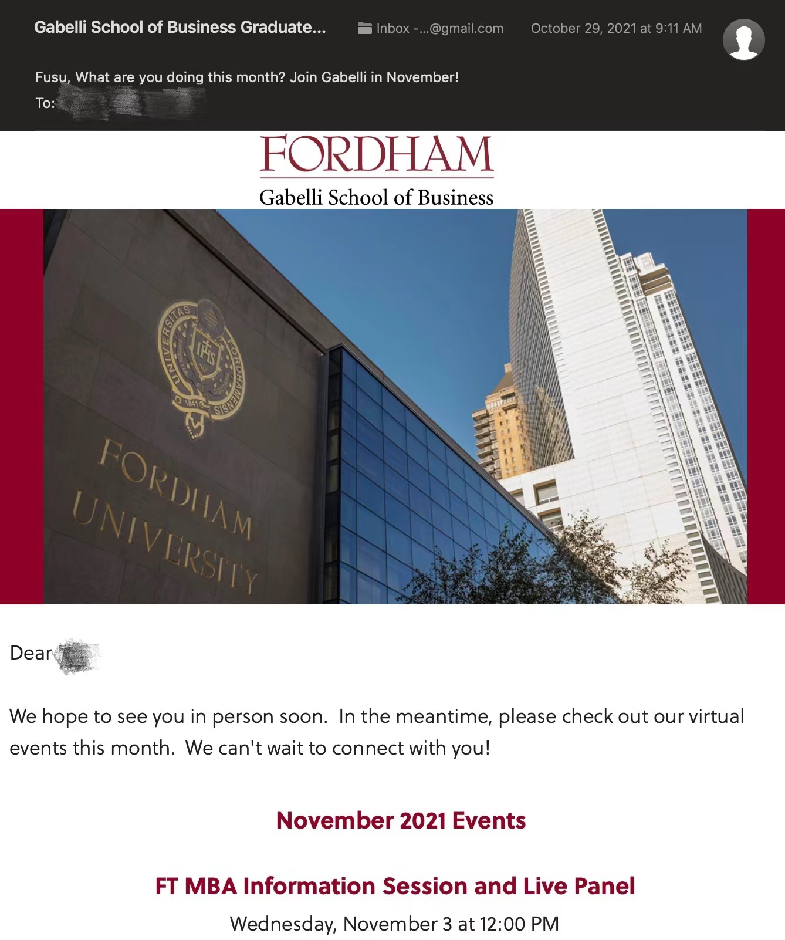
Have you ever received an email like this?

Slide 12
Unethical Use of Data
Online Tracker
Buying For Reputation
Buying Students' Grades
to send school emails to our personal email accounts, which we use more frequently to promote and advertise the school
to improve student resources / boost prospective financial resources / improve academic performance
to improve student resources / boost prospective financial resources / improve academic performance
Notes:
？

Slide 13
Example of Buying Students’ Private Information - Grades
Deontology
Consequentialism
Ethical
Unethical
ETS (TOEFL & GRE)
GMAC (GMAT)
IELTS
Common Application (for undergraduates)
DuoLingo
Invasion of students’ privacy
Unethical buying & selling system

Slide 14
Example of Gaining Academic Reputation Unethically
Academic Reputation
different lists have different ways of measuring
may lead schools to pay for "reputation" in order to have a higher reputation

Slide 15
4. Ranking Creates Inequality

Slide 16
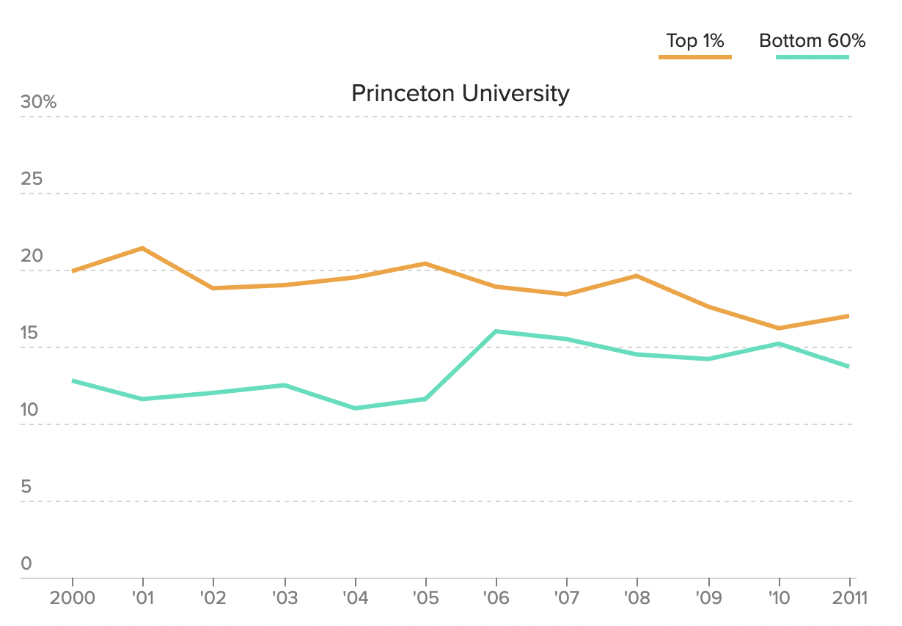
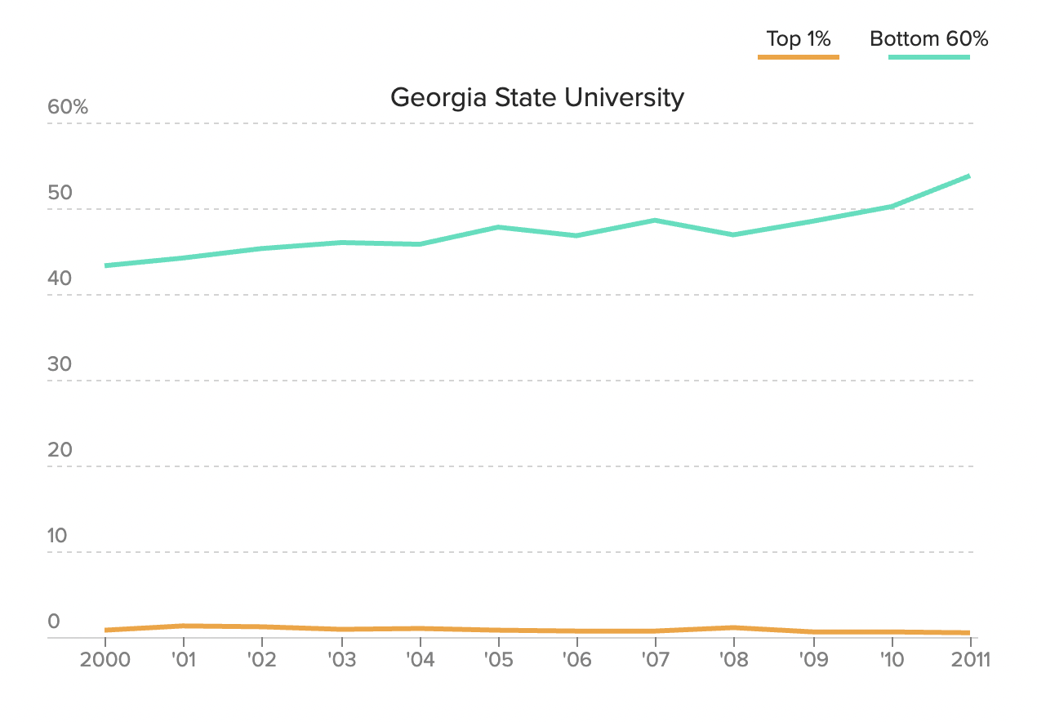
Inequality & Unfairness Treatment
More students from the top 1 percent of earners than the bottom 60 percent combined
Georgia State University has dropped 30 spots because of the emphasis on cultivating moderate-income students

Slide 17

College Legacy
• 17.5% of students at Harvard have at least one parent who is an alumni.
• legacies are admitted at a rate of 30%.
• Harvard’s acceptance rate just below 6%.
• This is not an “Addition look”

Slide 18
5. Misinformation & Fake News

Slide 19

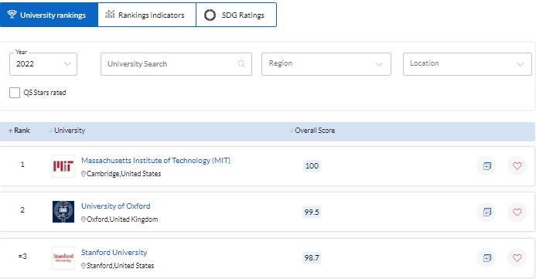
QS World University ranking
Academic Reputation (40%)
Employer Reputation (10%)
Faculty/Student Ratio (20%)
Citations per faculty (20%)
International Faculty Ratio (5%)
International Student Ratio (5%)

Slide 20


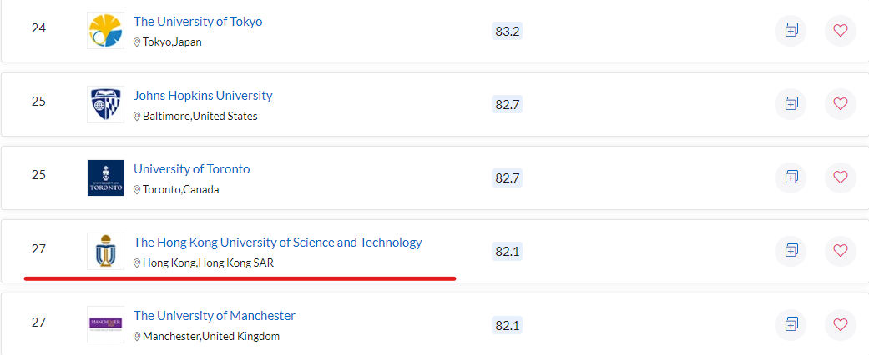
Hong Kong University of Science and Technology
- Ranks 27th in the QS
- AVG Ranking 111.5
- Variance 100.9
*Academic Reputation (40%)

Slide 21
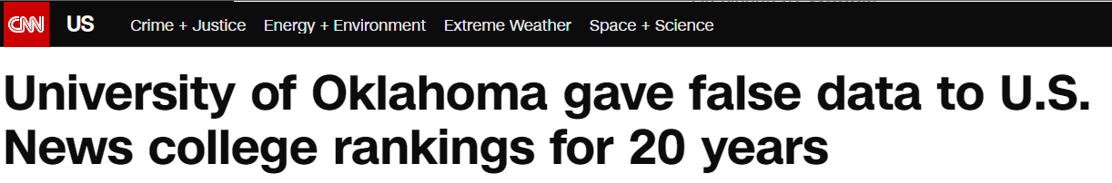

Universities give fake information and data to gain a higher reputation
For the 2019 Best Colleges rankings, the university originally said its two-year alumni giving rate was 14% but later informed U.S. News that the correct number is 9.7%.
The false data affected Oklahoma’s placement in the national universities, best value schools, top public schools, best colleges for veterans and A-plus schools for B students rankings and lists.

Slide 22

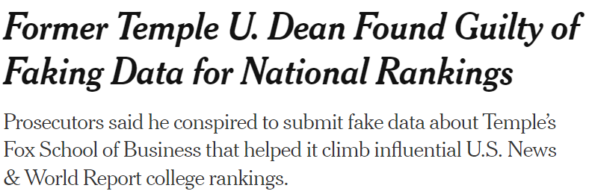
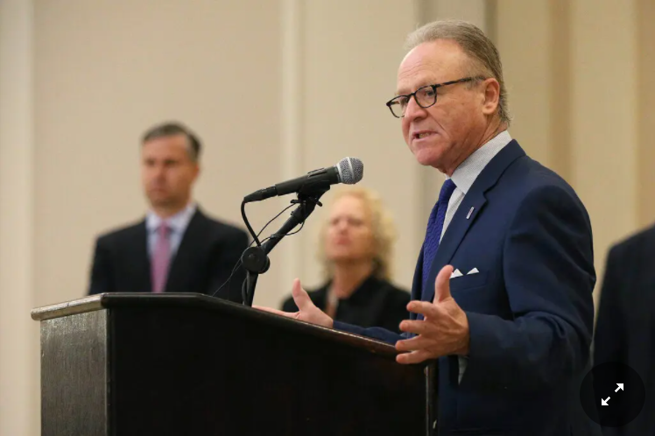
Enrollment in Fox’s O.M.B.A. and P.M.B.A. programs grew dramatically in a few short years, which led to millions of dollars a year in increased tuition revenues
Of course, Temple University and UO are not the only two institution that has been caught manipulating the college ranking system.

Slide 23
6. Summary
Brief summary
Limitations
Looking Forward

Slide 24
Outcome
Feedback Loop
Inequality
Student Privacy
Use of proxy
Disadvantage for those who are neither legacy students nor from wealthy families
Buying students’ information from testing websites
Spam Emails
Cognition Bias
Fake data/Misinformation
Unwanted exposure to colleges
Students do not choose right college for themselves
Advertising fake data to the public

Slide 25
Other important factors students take into account
Access to experienced researchers.
Well-established professional preparation program
Opportunities to be involved in graduate-level work
Location: close to home / far from home, small town /big city.
Study-abroad exchanges.
Robust student activities program:intramural sports.
Culturally diverse student body

Slide 26
Thank You For Listening!
We are now open for any questions :)

Slide 27
Related Resources
U.S. News: https://www.usnews.com/education/best-colleges/articles/how-us-news-calculated-the-rankings
https://www.usnews.com/best-colleges
QS: https://www.topuniversities.com/qs-world-university-rankings/methodology
https://www.qschina.cn/en/university-rankings/usa-rankings/2021
Forbes: https://www.forbes.com/sites/christiankreznar/2021/09/08/how-we-rank-americas-top-colleges/?sh=57d2138b43e0
https://www.forbes.com/top-colleges/
Wermund, Benjamin. “How U.S. News College Rankings Promote Economic Inequality on Campus.” POLITICO, https://www.politico.com/interactives/2017/top-college-rankings-list-2017-us-news-investigation/
Oklahoma: https://www.cnn.com/2019/05/23/us/university-oklahoma-best-colleges-ranking/index.html
Temple: https://www.nytimes.com/2021/11/29/us/temple-university-moshe-porat-fraud.html

